Slide 1
ABC Call Volume Trend Analysis- Project
Project Overview: In this Dataset of ABC Call Volume Trend Analysis, the data set is belongs inbound call process of Customer Experience department in Insurance category of ABC Company. The calls data is immensely distributed in each time intervals and have proper records of answered calls and unanswered calls. Analysis required to get good customer experience so that ABC improve their business and overcome the challenges what they face.
Approach: My Approach is very clear first to clean and normalize the dataset so that data could be easily readable. I drop some column which I found not required in my analysis. Then create table and proceed with pivot table then visualize my insight with the help of bar charts and pie charts.
Tech Used: Microsoft excel 2021.
Insight: The calls structure is fluctuated with time and there is shortage of agents to attend call like almost 30 % calls were abandon which create bad customer experience for the company. In my analysis I can plot my insight like more agents required to reduce calls abandon rate and attain good customer experience in future.
Please check each slide for every question conclusion and insight.
Analyze Sheet:-
https://drive.google.com/drive/folders/1IizG6Nua3ftsxlZTbUxd6bs1JEtHK8vt?usp=sharing

Slide 2
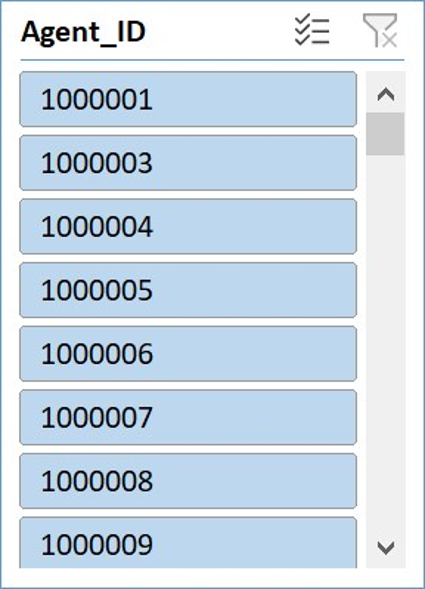
Task. a
In the above analysis we can understand that average call duration is high in morning time bucket from 10-11am and high in the evening time bucket from 6pm to 9pm. The minimum call received in noon time i.e from 12pm to 3 pm, the call duration traffic is very low that noon time. *Please refer analyze sheet for details.

Slide 3
Task.b
Insight: Maximum number of call received in the time bucket of 10am-11am till 12pm-13pm in these 3 hours time there are huge call flows then after 2 pm calls flow drop consistently. We can understand from this that majority of customers prefer to call in between 10 am to 1 pm.

Slide 4
Task. c
Working Bucket in Days | Sum of Call_Seconds (s) bucketwise in a day | Total calls per Hours in day | No of Agents working in a day( at 30% abandon rate) | No of Agents working in a day( at 10% abandon rate)
9_10 | 35313 | 10 | 1 | 2
10_11 | 53087 | 15 | 2 | 3
11_12 | 67751 | 19 | 3 | 4
12_13 | 72680 | 20 | 3 | 4
13_14 | 59693 | 17 | 2 | 3
14_15 | 76137 | 21 | 3 | 4
15_16 | 65689 | 18 | 2 | 4
16_17 | 59464 | 17 | 2 | 3
17_18 | 68155 | 19 | 3 | 4
18_19 | 53096 | 15 | 2 | 3
19_20 | 40141 | 11 | 1 | 2
20_21 | 25458 | 7 | 1 | 1
Grand Total | 676664 | 189 | 25 | 37
Assumption
Agent Working days in a week | 6
Total working days in month of (30days) | 24
Total unplanned leave in a month | 4
Net total working days in a month | 20
Total working hours in day of each employee | 9
Break time for lunch and snacks | 1.5
Net working hours in a days of employee | 7.5
Total call received in a day in hours | 189
No of employee received calls in day | 25
On an average 25 employees occupied only 60% actual working hours in a day
To get 90% Occupancy of actual working hours we need to apply Unitary Method- ( Total Agent required finally) | 37
Here I make some assumption and use Unitary method to find out the required manpower for each bucket, the above mentioned Assumption details are very clear as you can see after all calculation and observation I’m conclude that total no. of agent requirement is 37 to reduced the abandon rate to 10% only.

Slide 5
Task.d
Working Bucket in Days | Total calls per Hours in day | Total calls per Hours in day ( in %) | Agent required in night shift
9pm -10pm | 3 | 10.00% | 1
10pm -11pm | 3 | 10.00% | 1
11pm -12am | 2 | 6.67% | 1
12am -1am | 2 | 6.67% | 1
1am -2am | 1 | 3.33% | 0
2am -3am | 1 | 3.33% | 0
3am -4am | 1 | 3.33% | 0
4am -5am | 1 | 3.33% | 0
5am -6am | 3 | 10.00% | 1
6am -7am | 4 | 13.33% | 1
7am -8am | 4 | 13.33% | 1
8am -9am | 5 | 16.67% | 1
Grand Total | 30 | 100.00% | 8
Assumption
Agent Working days in a week | 6
Total working days in month of (30days) | 24
Total unplanned leave in a month | 4
Net total working days in a month | 20
Total working hours in day of each employee | 9
Break time for lunch and snacks | 1.5
Net working hours in a days of employee | 7.5
Total call received in a day in hours | 189
30% call received in night calls in hours | 57
Total No Agent required in Night Shift | 8
In the above analysis total 8 new agent required In the night to reduce the abandon rate to 10% to give good customer experience. Because insufficient manpower hamper business and tend towards bad customer experience for company.

Slide 6
Closing Note : I hope my audience understand my report, I tried to make precise and non technical so that every single person can get more clear insight about the dataset.
Thankyou For Your Patience

